Slide 1
Baseline Strategy

Slide 2
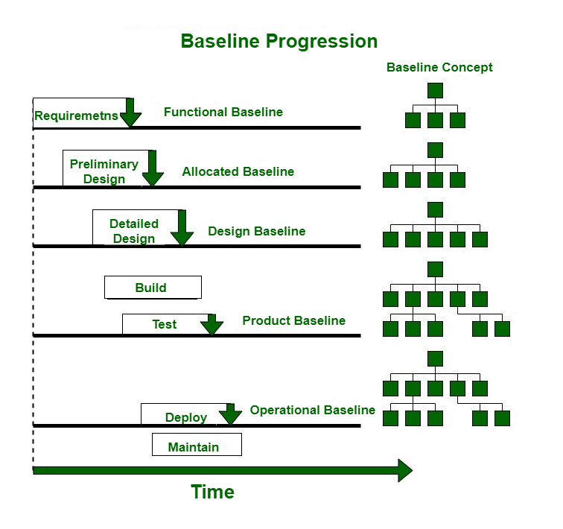
Review Rework Baseline
Project team members shall always baseline their work-products before sending for review and after closure of all review.
Naming Convention:
ProjectName_RVW/RWK_FeatureName_Phase_DDMMYYYY
Example
BR01_RWK_PORT_SWE.1_05012024
Internal Release Baseline Progression
- Functional Baseline (FB)
- Allocated Baseline (AB)
- Design Baseline (DB)
- Product Baseline / Project Baseline (PB)
Naming Convention:
ProjectName_XX_FeatureName_Discipline_DDMMYYYY
Example:
BR01_FB_VMC_SYS_15122023
Customer/Platform Release Baseline
Project Container shall be created based on milestone and baseline all work-products
Naming Convention:
ProjectName_CR/PL_Milestone_DDMMYYYY
Example
Bootloader_PL_M1_21122023

Slide 3
Thank You

